Slide 1
The Danger of a Single Story
Class with students from English Access Microscholarship Program
Duration: 90 minutes
Number of students: 17
Age of students: 14-16 years old
Topic: stereotypes
Teacher: Branka Dačeski

Slide 2
Themes: The blindmen and the elephant – poem Stereotypes in general The danger of a single story Stereotypes about Americans and Serbians Conversation with our guests about stereotypes
Lesson Objectives:
By the end of this lesson, students will be able to
Students will develop sensitivity to others' points of view.
Students will understand the importance of having as much information as possible before coming to conclusions.
Be able to give reasons to their statements, and understand how important is “why?”
Be able to give their reasons pro and con some stereotypes, that is, to think critically about stereotypes

Slide 3
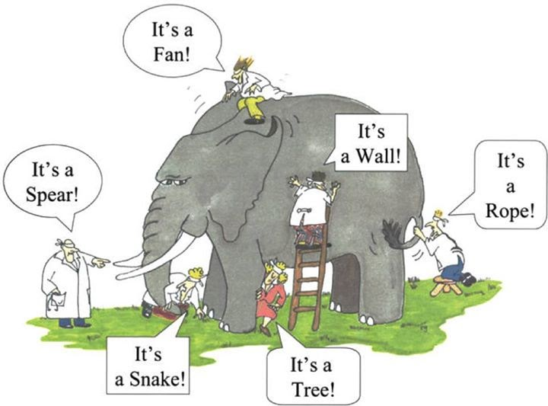
Warmer / Energizer (15 min)
Watch the video:
The story about an elephant and
6 blind men
the blind men and the elephant
Discuss.

Slide 4
Activity 1 (25 min)
Stereotypes – What is a stereotype – revise – they talked about stereotypes in the previous lesson.
Let’s watch a video - The danger of a single story
While watching and listening – pay attention, write down examples of a single story:
Single story – show people as one thing, and that is what they become
(1. A single story – poverty (a houseboy – Fide)
2. A single story of Africa - her roommate – wondering about her English (tribal music, presumed she didn’t know how to use a stove) – patronizing well-meaning pity
Power – tell a story of another person, but not only that, make it a definite story of that person)
Ask students to think about “single stories” they have heard about, or know about.
They share and discuss.

Slide 5
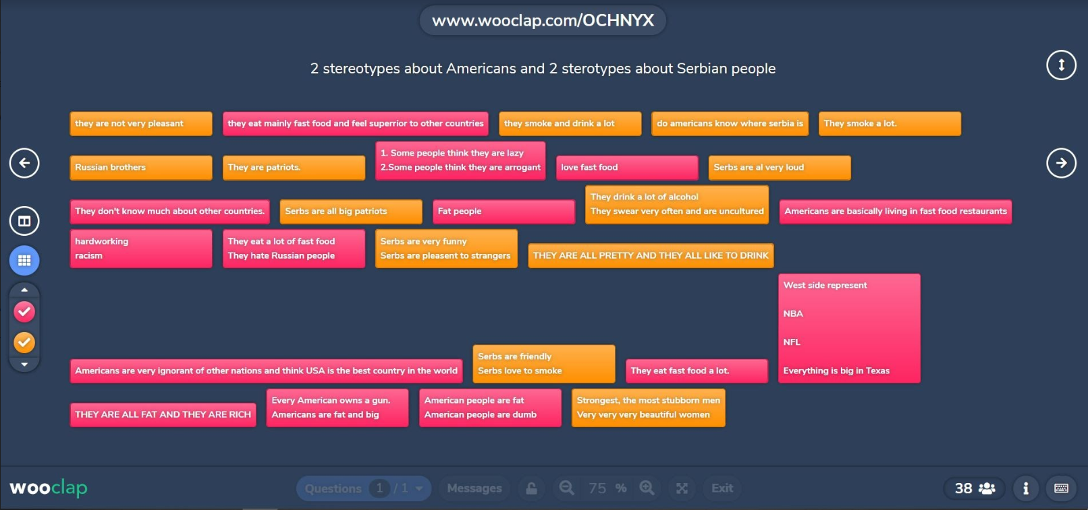
Each student writes two examples of stereotypes about Americans and two about Serbian people. We will take a look at these stereotypes and talk about them later with our guest speakers. (we will use this app for writing down stereotypes https://app.wooclap.com)

Slide 6
Activity 2 (10 min)
Talking about stereotypes (about Americans and Serbian people) with three guests (American citizens who have lived and worked in Serbia)
Activity 3 (30 min)
Students are divided into three breakout rooms, and each of the guests is with one group of students. Students ask the guests about stereotypes, and the guests give them their point of view. Also, since our American guests have lived in Serbia, they can also give their perspective about stereotypes about Serbian people.
After 10 minutes, they change the room, and talk to a different group of students. By the end of the lesson, each guest will have spoken to each group of students.

Slide 7
Activity 3 (10 min)
Let’s see what stereotypes we decided to burst.
Link to recording (part) https://www.youtube.com/watch?v=E_bbl2VJxtk&feature=youtu.be

Slide 8
English language teacher in primary school “Rada Subakic” in Gruza,
English teacher in English Access Microscholarship Program
branka.decka@gmail.com

